Slide 1
RampUP
FR
FABRIKAM RESIDENCES
App Prototype by Shelby Ehret

Slide 2
Introduction
RampUP App Prototype
Design/Content
Purpose
Functions
Notes:
The purpose of this app will be to enable people with accessibility needs to locate ramps in various locations.
The the app can also benefit camera crews, truck drivers, and bus drivers by enabling them to locate load in ramps and docking areas.
In the city, especially, it is hard to locate where a ramp may be ahead of time. The functions of the app will be to use an overlay map (Google Maps) to build GPS locations in RampUP and load where ramps may be for accessibility needs. Additionally, as the app spreads, another function of the app would be for people to scan a RampUP sticker (similar to yelp check-ins) to make sure that our reporting of ramps and loading docks is accurate and is accessible.
If a person notices an issue with the ramp, they can use that same check in feature to report a problem or submit a photo that will then be relayed to the proper channels for correction

Slide 3
Initial Design
In this initial sketch, I wanted to design an app that is easy to use, accessible, and has a color guide that works with visual impairments. I based the content from a mix between Google Maps options and Yelp (with a few of my own additions). I liked the idea of having a homepage where you can connect to most of the content with one click, as some users have accessibility needs that restrict them with a complicated design. I then used Adobe Capture to scan the sketch into my Adobe cloud and used it in Illustrator and XD.
Materials: Sketch pad, Micro-Line Fine Tip markers
Notes:
Overall, I would like this app to serve those will accessibility challenges, so they are able to plan appointments or trips ahead of time. The others that can use this app for professional purposes is an added benefit to what I am trying to achieve. At this moment, through some quick research, there are only apps that allow you to locate boating docs to help load boats into the water. I noticed there is a gap in the market that I believe I can fill with this app prototype. There is a real need for this sort of service in all communities.

Slide 4
Discovery Stage
Report
Methods Utilized
Tree Testing
Card Sorting (Closed)
User Profiles
Notes:
Rationale of Methods:
I would like to use both tree testing and card sorting methods that I had used in my previous UX research studies. I liked the results I saw from card sorting when users can give feedback on how things should be categorized and that leads to new discoveries of what the app can look like. I would use open card sorting because early on, I may not know yet which categories I will be using in the app prototype. Also, I would like to use tree testing to discover what the flow of the app should look like for users. I would like to see if a collapsible menu would be best for keeping the prototype organized.
User Profiles:
I would like to keep the same 5 users that I have tested before with card sorting and tree mapping. The profiles of the participants are working professionals and students. The participants range in age from 21 to 32. I feel like I would like to see how different needs are assessed based on different users. The participants include males and females as well.

Slide 5
Discovery Stage
Findings/Results:
Tree Testing
Notes:
Question 2
Multi-line text
5 of 5 participants answered
Would you organize the information differently? If so, what would you do?
Out of all the tasks completed by participants, 67% ended up at a "correct" answer.
WHAT WOULD YOU ADD TO THE APP?
Participant 3 :Accessibility tab with another tab that says entry ramp finder
Participant 4: Parking and drop off information (do I have to navigate more than just the building itself)
Participant 5:Door map with information about the type of door at each entrance (whether or not there is an automatic door)

Slide 6
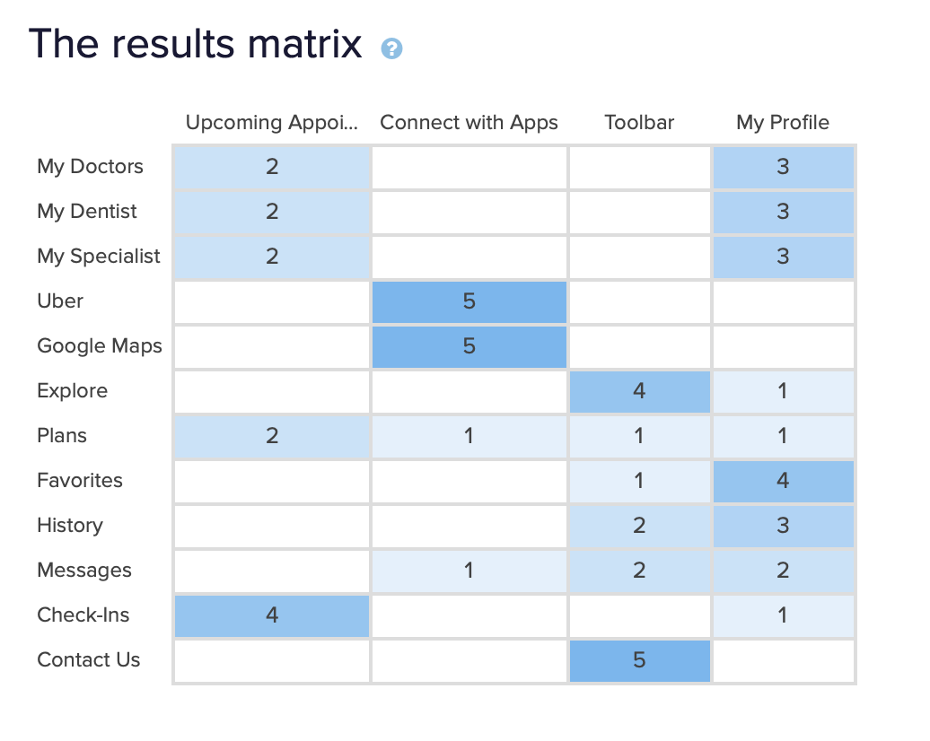
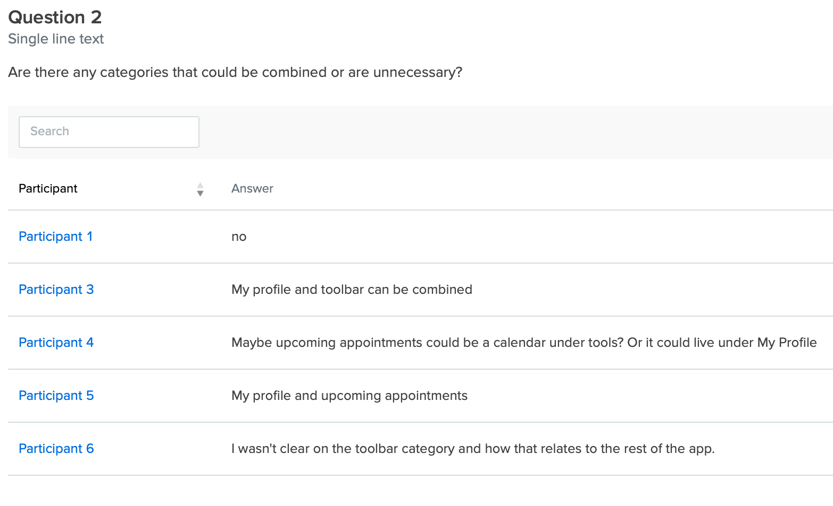
Discovery Stage
Findings/Results:
Card Sorting (closed)
Notes:
Card Sorting:
What category would you add, if any?
No
Revise “toolbar” to the word “general”
Pharmacy
n/a
FAQ tab

Slide 7
Idea-Testing Stage
Report
Method(s) Utilized
User Backgrounds
Notes:
usability studies - remote moderated testing through wireframe sharing to gather feedback from participants. Shared a link of my wireframe design through AdobeXD and asked for comments.
Same group of 5 participants (same from the discovery stage) From the discovery phase to the idea testing stage,. The group of people involved will be a mix of professors and students.
Later, I will add additional users from usertesting.com to add fresh feedback

Slide 8
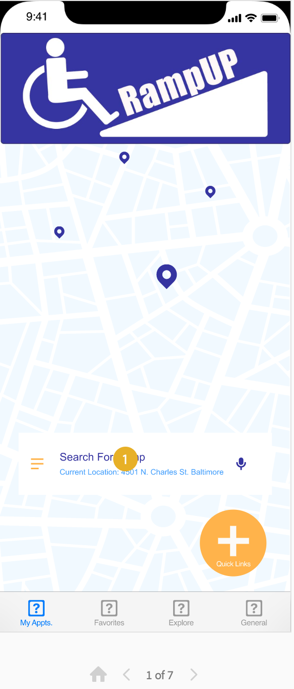
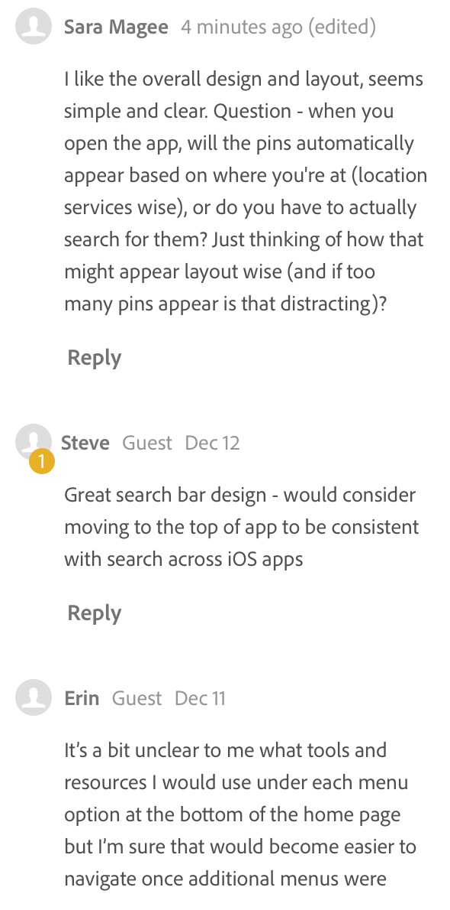
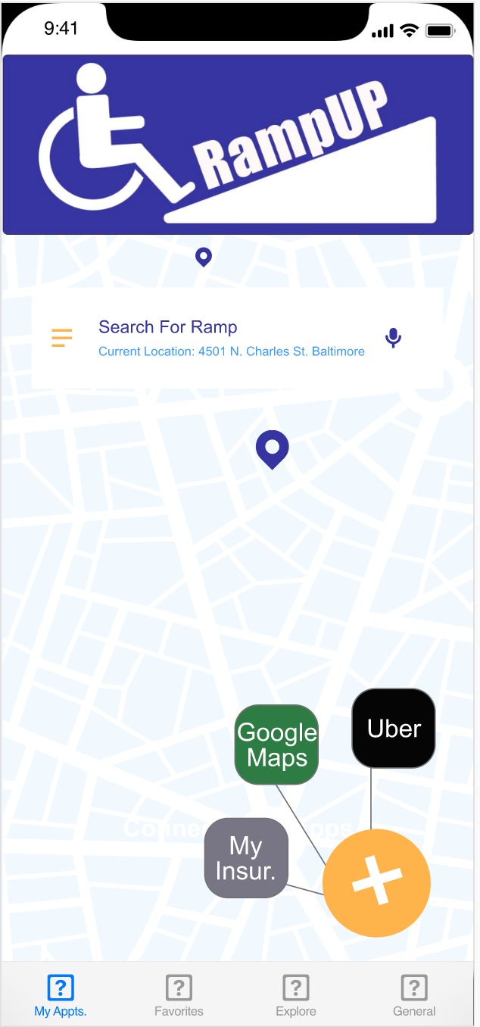
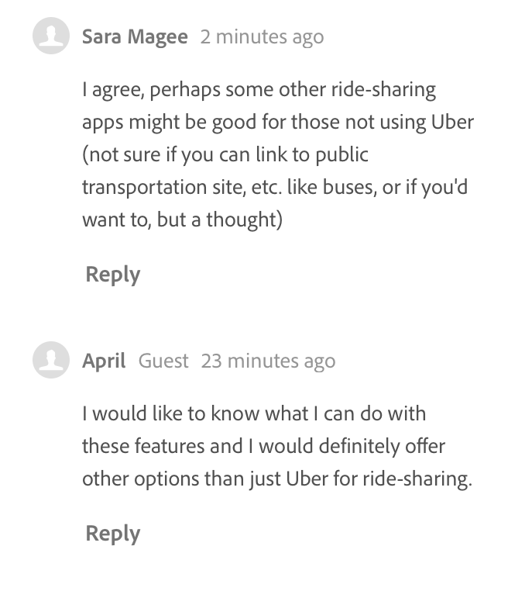
Idea-Testing Stage
Findings

Slide 9
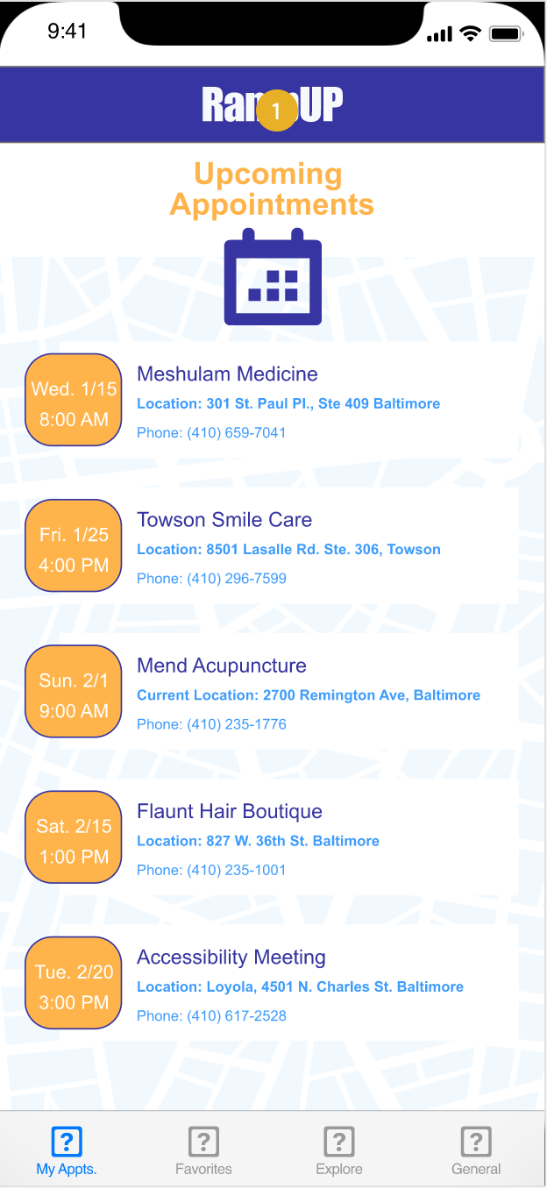
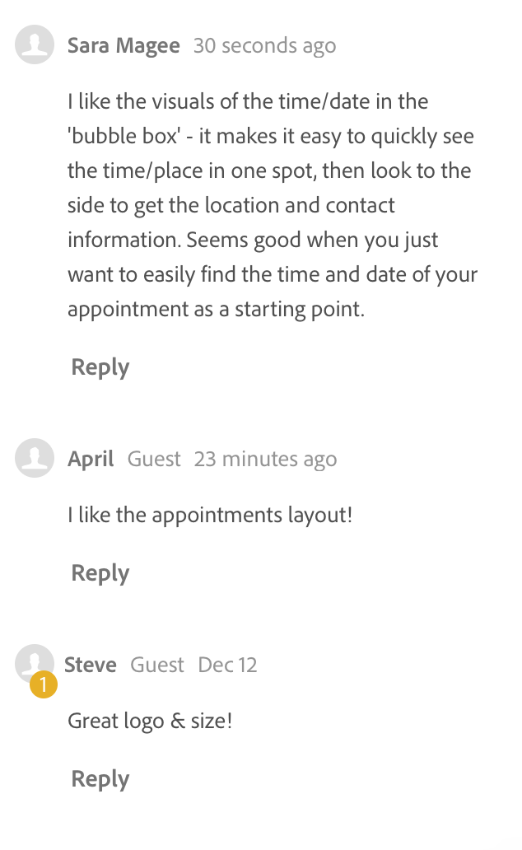
Idea-Testing Stage
Findings

Slide 10
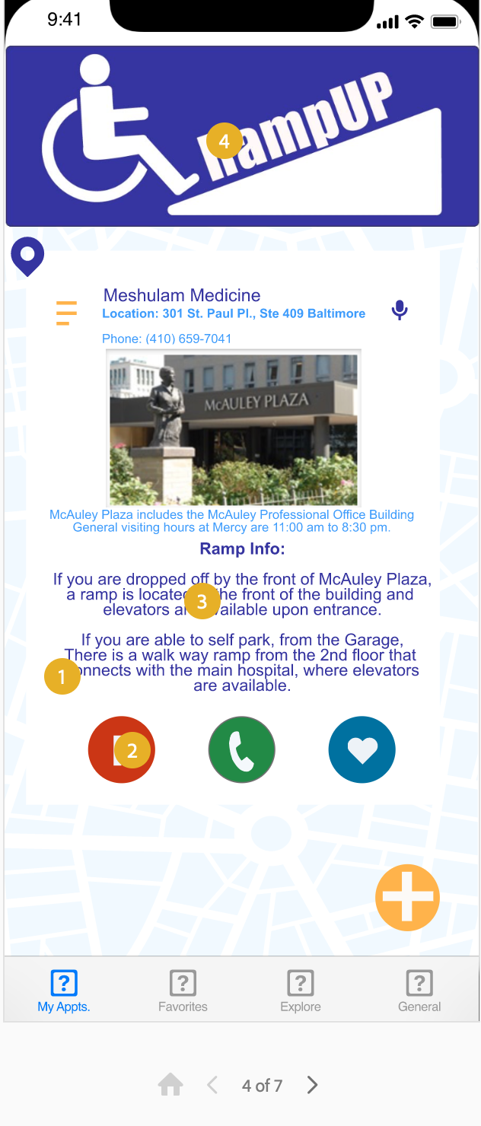
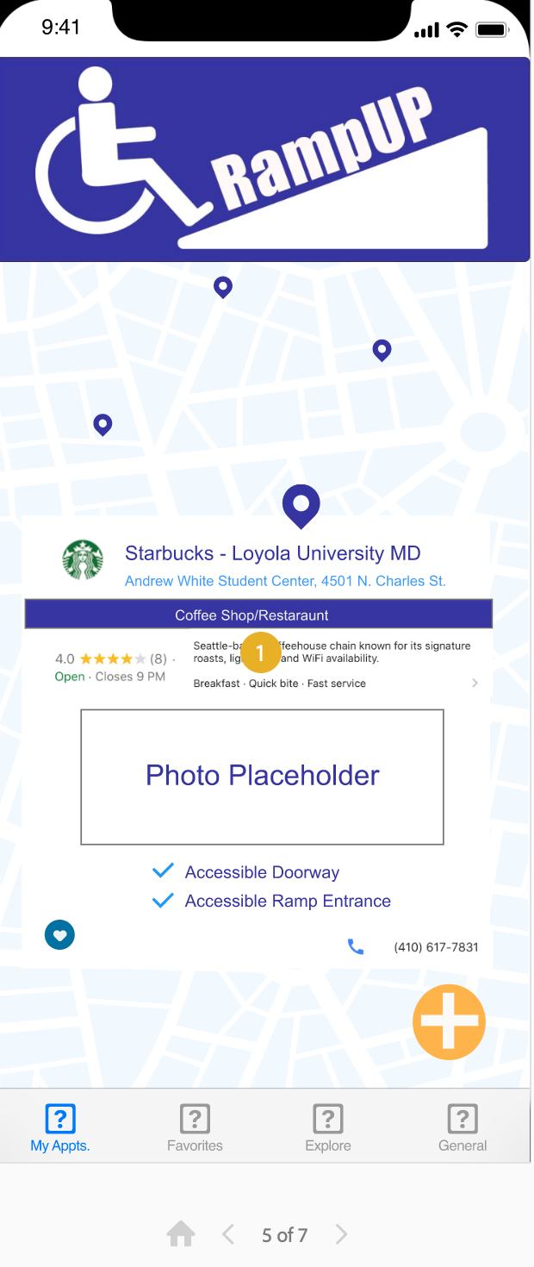
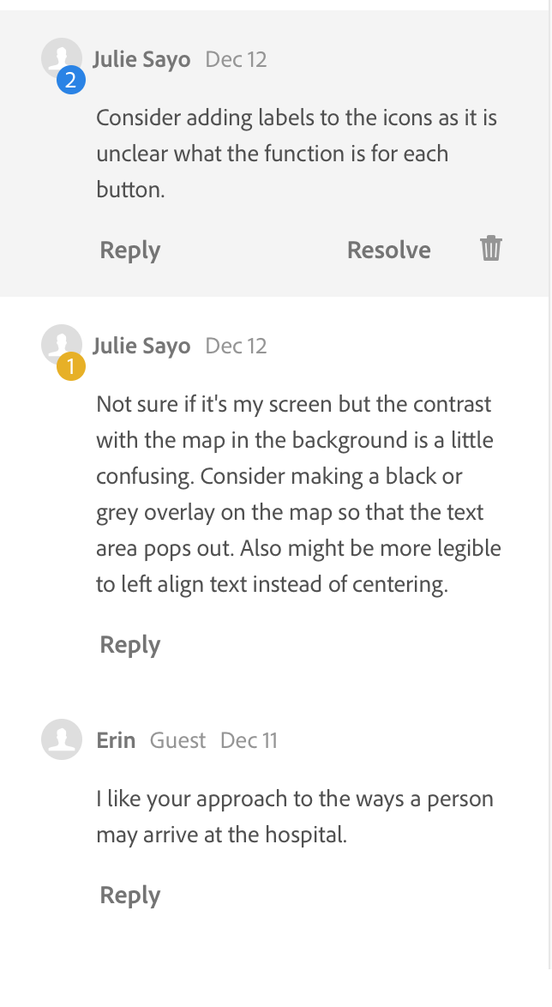
Idea-Testing Stage
Findings

Slide 11
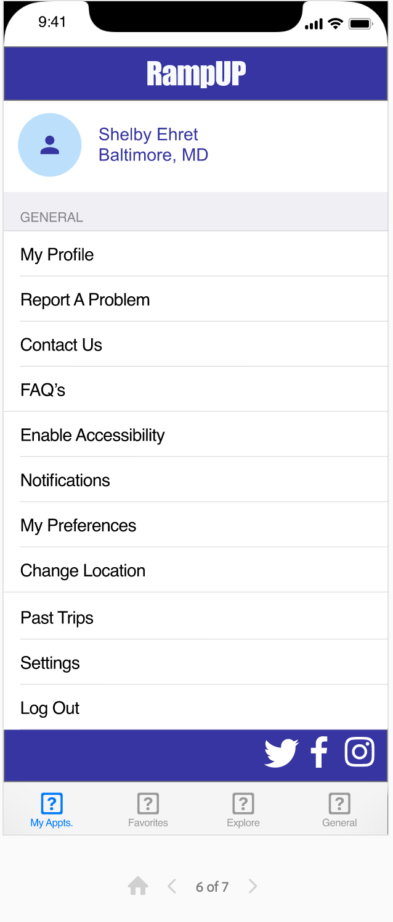
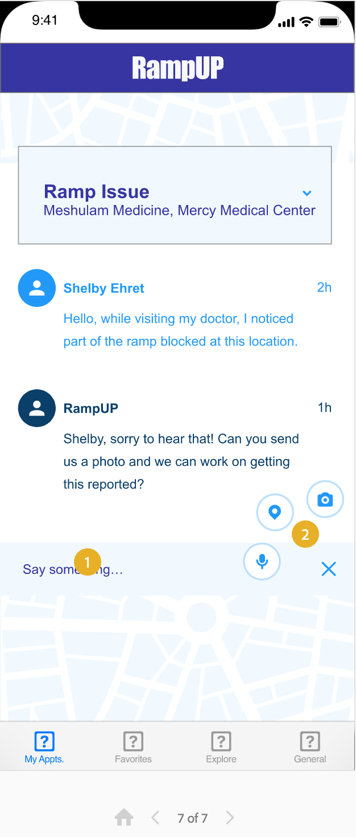
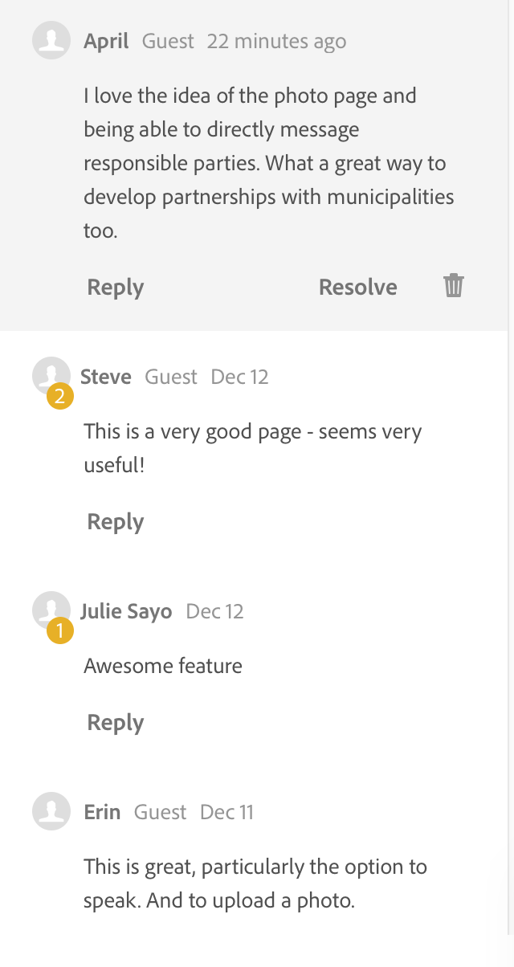
Idea-Testing Stage
Findings

Slide 12
Content Creation Stage
Evidence
Link to Content:
Explanation of Design Principles/Best Practices:
https://xd.adobe.com/view/05438a9a-1654-49a6-46d6-639e899888e3-7372/
iOS Guidelines

Slide 13
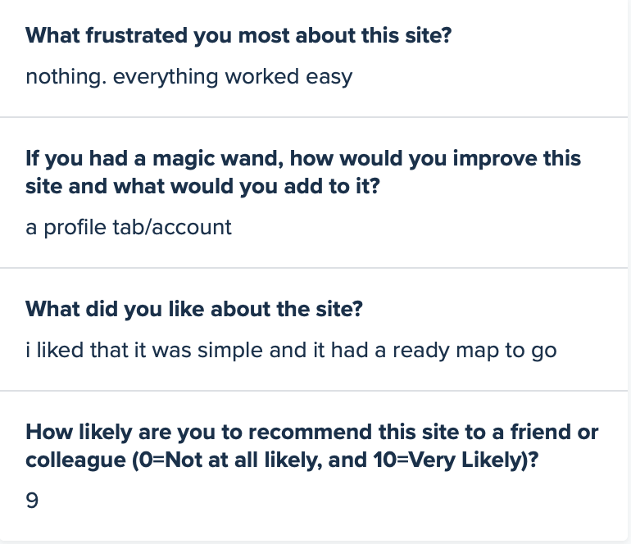
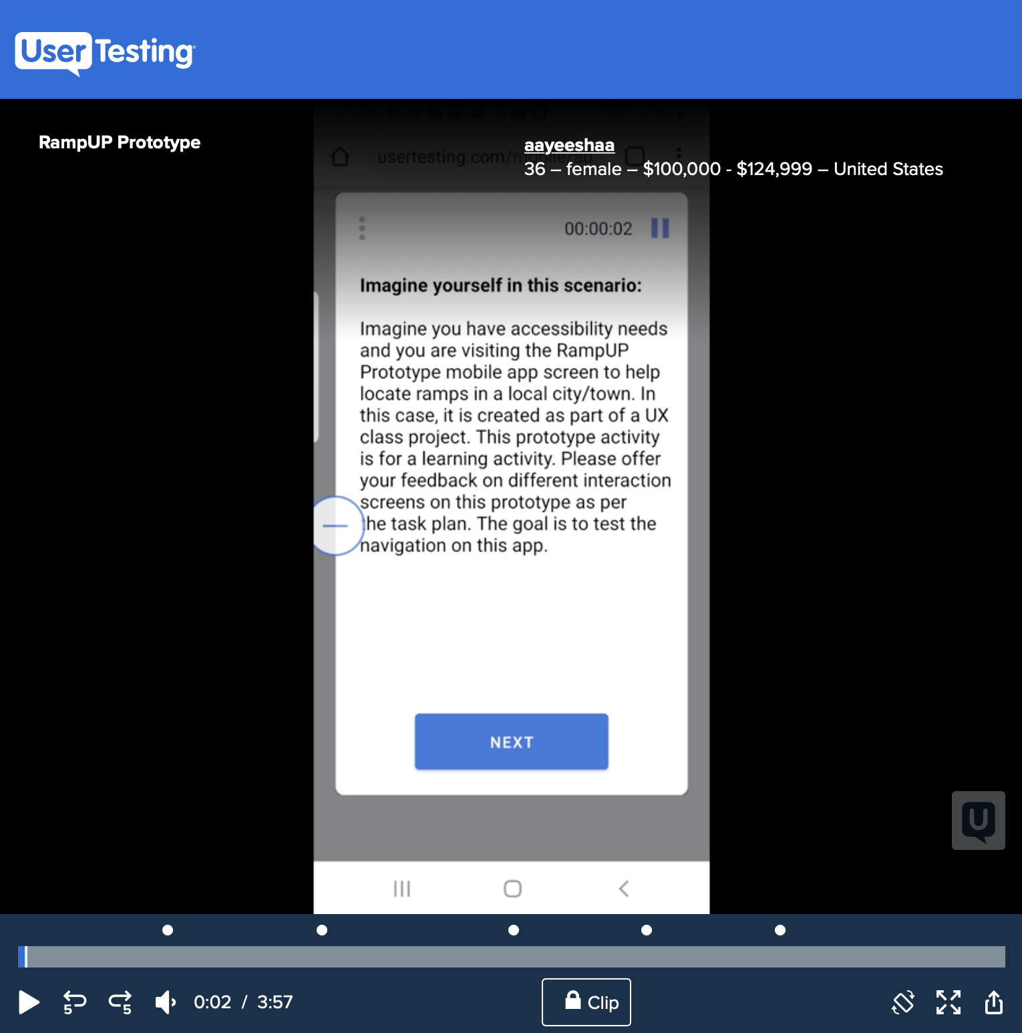
UserTesting.com
Findings
Introduction/Scenario:
Imagine you have accessibility needs and you are visiting the RampUP Prototype mobile app screen to help locate ramps in a local city/town. In this case, it is created as part of a UX class project. This prototype activity is for a learning activity. Please offer your feedback on different interaction
https://www.usertesting.com/v/9d69335a-f8fb-4652-aa57-9ef4a37fcf6e?encrypted_video_handle=b3408214-b3ba-48bc-a65e-749cf5b7068a#!/notes
Notes:
Summary of results/links:
All interaction screens worked easily for the User tester and they noted that the process was quite understandable.
Plan for Accommodations:
I plan to have another round of user testing before undergoing another round of revisions and accommodations.

Slide 14
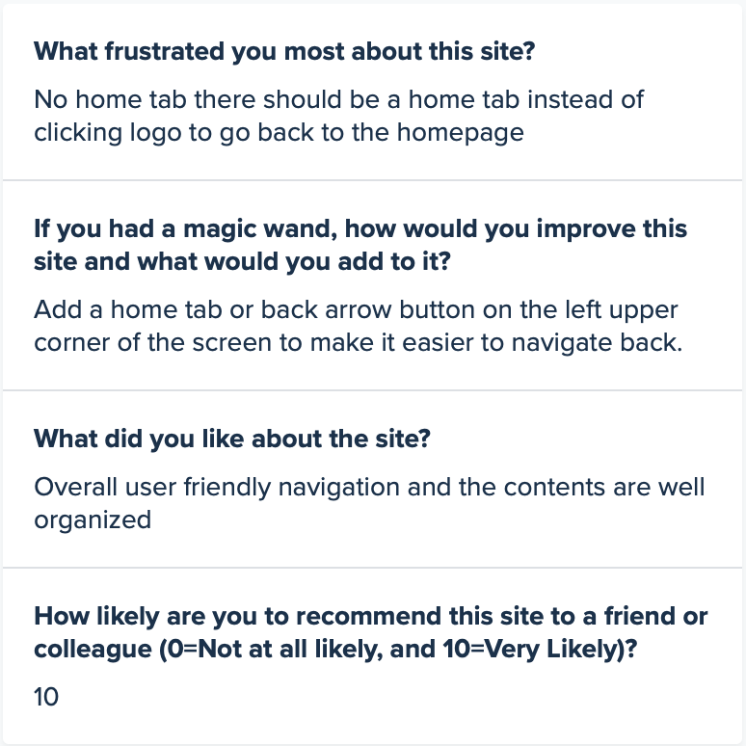
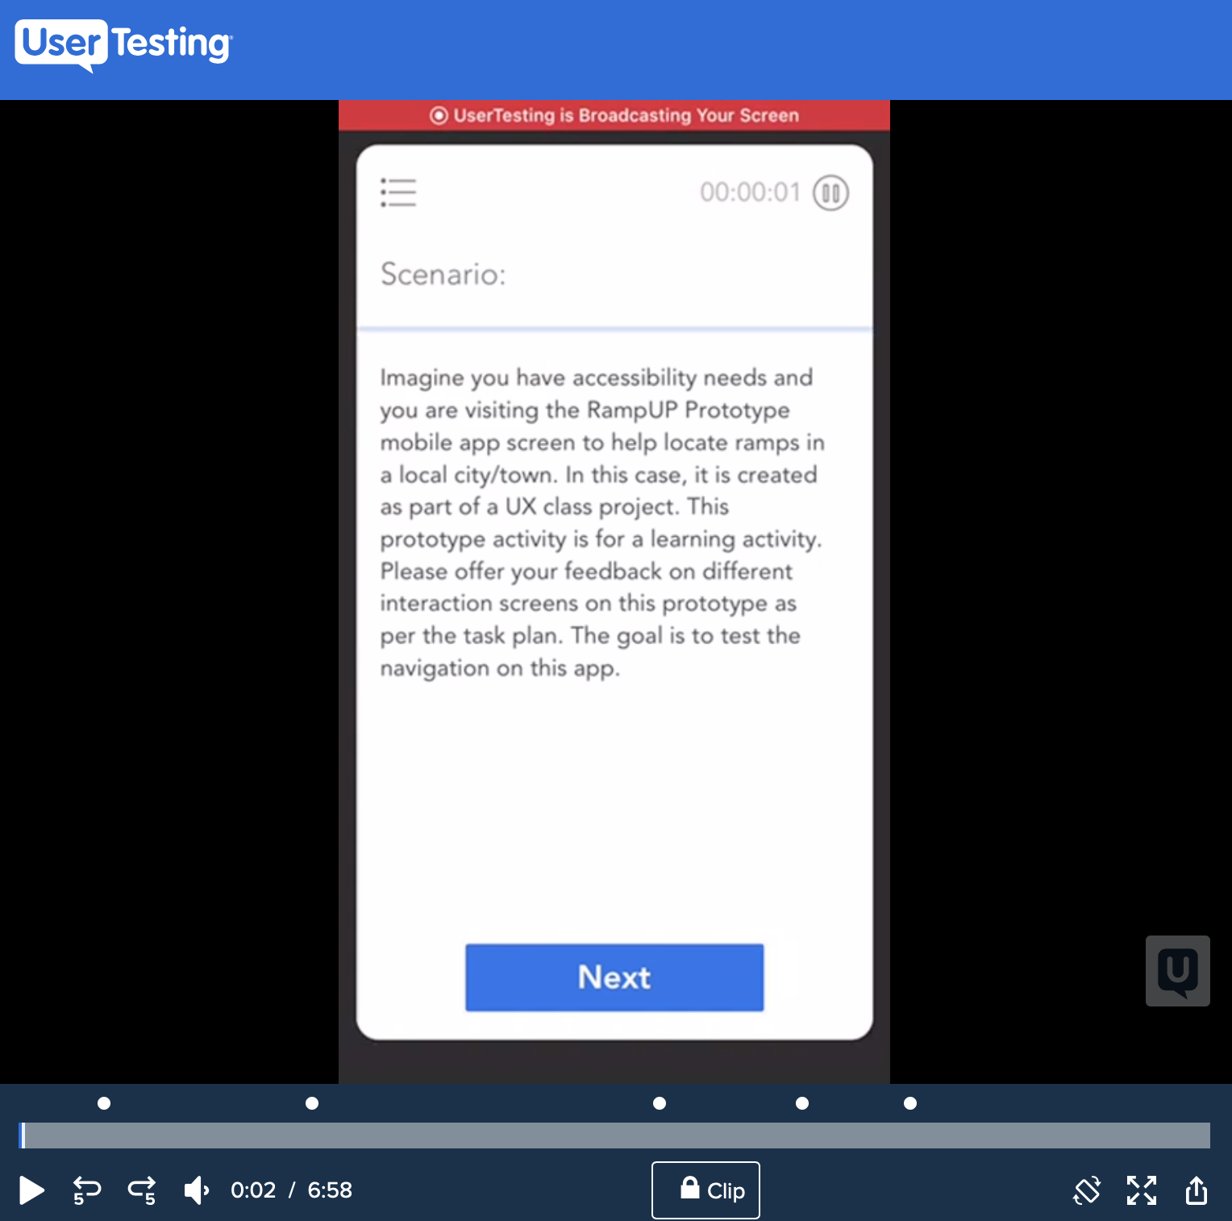
UserTesting.com
Findings
Introduction/Scenario:
Imagine you have accessibility needs and you are visiting the RampUP Prototype mobile app screen to help locate ramps in a local city/town. In this case, it is created as part of a UX class project. This prototype activity is for a learning activity. Please offer your feedback on different interaction
https://www.usertesting.com/v/488c5356-c99e-4afb-9f06-0184325c116c?encrypted_video_handle=12c67d8f-069a-43de-9dca-2088e090a864#!/tasks
Notes:
Summary of results/links:
User stated it was very easy to navigate
Plan for Accommodations: I have considered adding a different set up for navigating home, such as the Instagram home button located on the bottom toolbar so you can maneuver home from any page. I will work on an edit as I bring my prototype into my capstone

Slide 15
Final Reflections // Thoughts on HCD Approach to Designing
Notes:
Final reflections on the process
Thoughts on HCD:
The process is focused on finding, not only the right problem, but fulfilling human needs – I noticed what was missing from a sitel ike Google Maps and I thought this could solve a problem (even if it became a plug in instead of an actual app)
Has the user in mind (the user might have accessibility needs so I tried to design something that met a wide variety of accessibility standards – color, positioning, ease, etc)– necessity for UCD

Slide 16
Works Cited:
Style Guide Resource:
https://www.idpwd.com.au/resources/style-guide/
Apple Design Resources:
https://developer.apple.com/design/resources/
Adobe Products/Resources:
https://www.adobe.com/products/xd/resources.html#panel-3
Apple Color Guideline - made sure all color used on the site is accessible
https://developer.apple.com/design/human-interface-guidelines/ios/visual-design/color/
Photos courtesy of:
https://unsplash.com
Google Permissions:
https://www.google.com/permissions/trademark/logos-list/
Uber Assets:
https://developer.uber.com/docs/riders/guides/design-guidelines

Slide 17
Thank You.
Shelby Ehret
410.617.2528
slehret@Loyola.edu
Loyola.edu

