Slide 1

Final Project App Prototype:
NeighborLend
Whitney Myers
ME720; Fall 2019

Slide 2
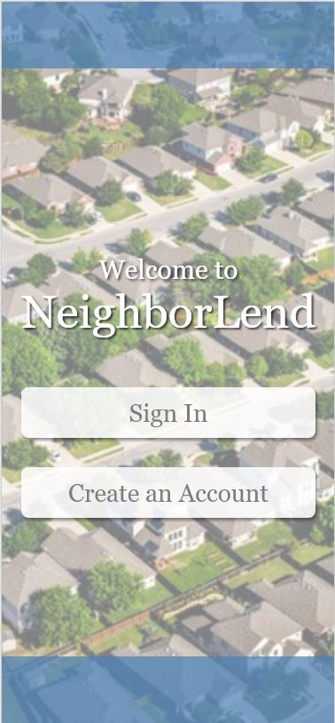
NeighborLend
Users can Opt-In to list items for rental or lending out to neighbors and those in their proximal area

Slide 3
Discovery Phase
Method: One-on-One Interviews
User Background
  Wide variety of backgrounds and living situations
    Renters and Owners, Large Homes, Small Homes, Apartments, Large and Small Neighborhoods
Research Findings
  All users found themselves in a situation where they did not have something they needed or wanted, or something they wish they could access off-hand

Slide 4
Idea-Testing Stage
Method: One-on-One Interviews
User Background
  Same testers from the Discovery Stage
Research Findings
  All subjects reacted positively as a whole to the idea
  Some concerns over privacy and listing area/address
  Concern on usability of app from some older testers who are less familiar with the ‘crowd-sourcing style’

Slide 5
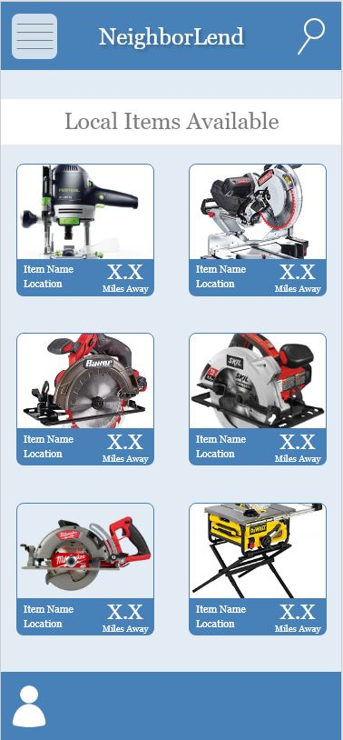
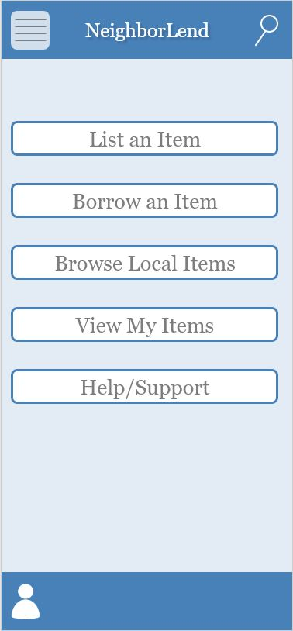
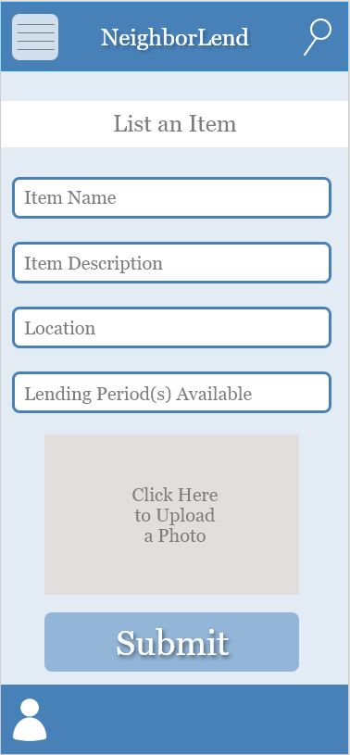
Content Creation
NeighborLend Prototype Link

Slide 6
Testing Results
UserTesting Test #1
Overall well received and well liked
Menu and functionality made sense
Questions on specific location function
Intuitive home page click
Scored 10/10; mentioned this is an app he would use and had some great feedback

Slide 7
Testing Results
UserTesting Test #2
Also well received and well liked
Simple, straightforward, easy to use and understand
Item Description Feedback – use qualifiers or guidance on what to write
Renting vs. Borrowing filter/function
Searching different locations
Scored 10/10, also mentioned this was an app she would use

Slide 8
Final Thoughts
Future plans with this project?
Human Centered Design is imperative to keep in mind during any kind of ideation or content creation, no matter what it is
Human feedback and response leads to more successful end results

